Slide 1
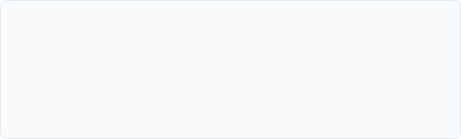

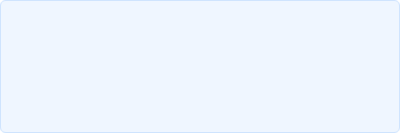


Predicting 2-Year Customer Churn
Retention Analytics & Cost Optimization
MODEL & DECISION THRESHOLD
VALIDATION SET FINANCIAL IMPACT
Trained a Calibrated Logistic Regression model on 1M customer records to predict 2-year suspension risk.
$4,282,800
Shifted decision threshold from default 0.50 to 0.05, intentionally prioritizing high recall over baseline accuracy.
Threshold 0.50: $6.59M
•
Threshold 0.05: $2.30M
ASYMMETRIC ECONOMIC RATIONALE
PRODUCTION PLAYBOOK
Missing a true churner results in severe lost lifetime value compared to the minor cost of an unnecessary retention offer.
• Scoring Cadence: Batch score customer accounts on a weekly or monthly schedule.
MISSED CHURNER
RETENTION OFFER
• Action Trigger: Automatically initiate retention campaigns for probability ≥ 0.05.
$5,000 loss
$200 cost
• Capacity Management: If campaign resources are constrained, prioritize customers strictly by highest-risk deciles.
Mudra Verma | Executive Summary & Strategy Deliverable
Confidential & Proprietary

